Slide 1
CPSC 481 Artificial Intelligence
Dr. Anand Panangadan
apanangadan@fullerton.edu

Slide 2
What we will cover today
Types of environments

Slide 3
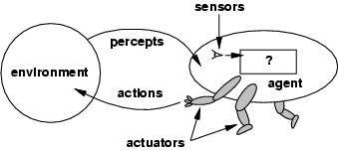
Intelligent Agents
An agent is anything that can be viewed as perceiving its environment through sensors and acting upon that environment through actuators
Human agent has eyes, ears, and other organs for sensors; hands, legs, mouth, and other body parts for actuators. Robotic agent has cameras and infrared range finders for sensors; various motors for actuators.
The agent function maps from percept histories to actions: [f: P* → A]
The agent program runs on the physical architecture to produce
agent = architecture + program
Rational agents use
performance measures
environment
actuators
sensors
Notes:
+Rational Agent: For each possible percept sequence, a rational agent should select an action that is expected to maximize its performance measure, given the evidence provided by the percept sequence and whatever built-in knowledge the agent has.

Slide 4
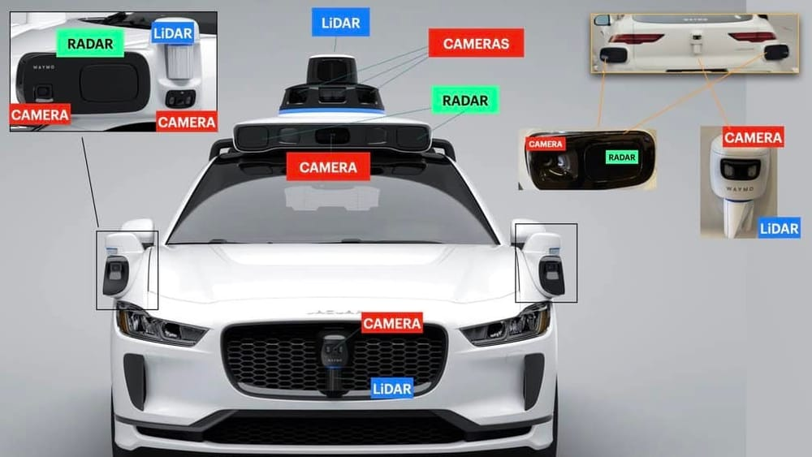
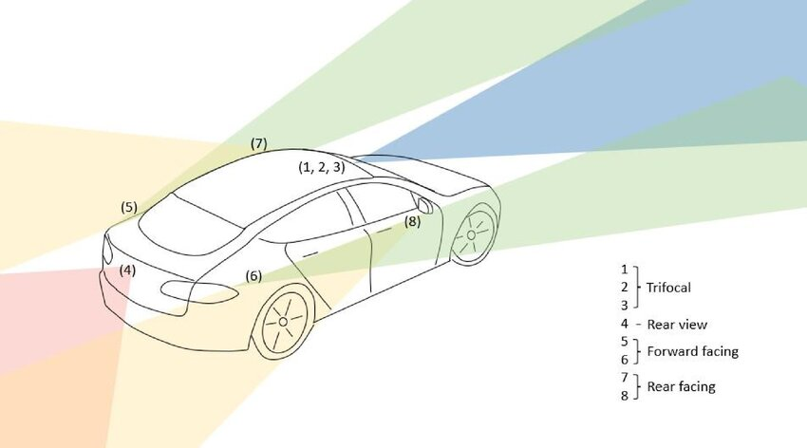
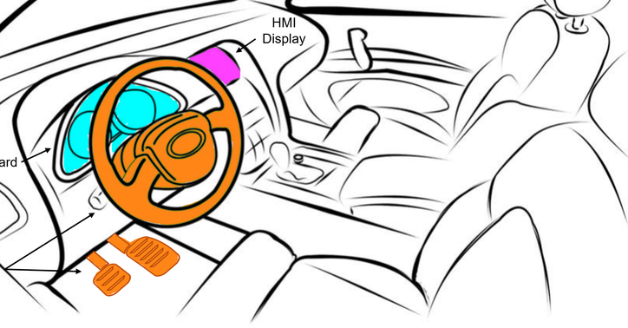
Self-driving car sensors and actuators
Mandujano-Granillo, Jesus & Candela, Milton & Ortiz-Vazquez, Juan & Ramírez Moreno, Mauricio Adolfo & Tudón-Martínez, Juan & Félix-Herrán, Luis Carlos & Galvan-Galvan, Alfredo & Lozoya-Santos, Jorge. (2024). Human-Machine Interfaces: A Review for Autonomous Electric Vehicles. IEEE Access. 12. 121635–121658. 10.1109/ACCESS.2024.3450439.

Slide 5
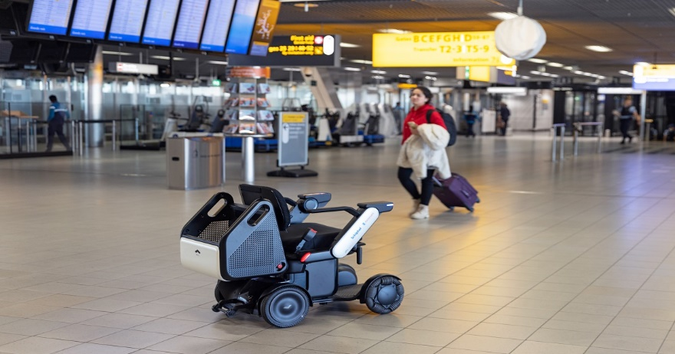
Class work
List the
performance measures
environment
actuators
sensors
For (each of):
A self-driving wheelchair
A robot vacuum cleaner (Roomba)
A robot soccer player

Slide 6
Classwork
On Google Drive
Link on Canvas
Go to today’s date and section
Editable and viewable by all
Create a new Google Document and name it with your groupmates’ names
E.g.: Garcia-Joshi-Nguyen
Write the names and role of group members
Roles: manager, recorder+presenter, timekeeper
Add your answers
Will not be graded but used for class participation points
Can easily share with rest of class

Slide 7
Properties of Task Environments
Fully observable vs. partially observable: – Fully observable if sensors detect all aspects of environment relevant to choice of action
Partially observable due to noisy, inaccurate or missing sensors
E.g., in card games, not possible to see what cards others are holding
Single agent vs. multiple agents: in single agent environment, no other “thinking” entity
Multiple agents: other entities whose goals depend on your own
Cooperative: improving other’s situation, helps your own
Competitive: improving other’s situation, worsens your own
Deterministic vs. stochastic: Deterministic if the next state of the environment is completely determined by the current state and the action executed by the agent
Stochastic if what happens is affected by randomness
E.g., roll of dice in a game
Notes:
Note: observable partially observable is different from known and unknown environment. E.g., knowing the game of rules (known) but can be still partially observable (card game). Don’t know the rules (unknown) so need to learn them.

Slide 8
Properties of Task Environments-cont.
Episodic vs. sequential: episodic if a current action will not affect future actions - the agent’s experience is divided into independent episodes. E.g., mail sorting system
Sequential if current decisions affect future decisions.
E.g., navigating a car is sequential, most games
Static vs. dynamic: Static if the environment does not change as the agent is deciding on an action. E.g., chess
dynamic if the environment may change while the agent is thinking
Discrete vs. continuous: in discrete environments, actions/percepts can take only specific values (e.g., chess); in continuous environments, there can be infinite such values.
Signals constantly coming into sensors, actions continually changing. Car driving is continuous.
Known vs. unknown: In a known environment, the outcomes for all actions are given, i.e., the rules of the game are known
If unknown, the agent will have to learn how it works.
Notes:
Note: observable partially observable is different from known and unknown environment. E.g., knowing the game of rules (known) but can be still partially observable (card game). Don’t know the rules (unknown) so need to learn them.

Slide 9
Example: playing soccer
Partially observable – Player cannot detect all the things on soccer field that can affect its action, for e.g. it cannot determine what other players are thinking.
Multi-agent – There are many players in a soccer game.
Stochastic – Given the current state and action executed by agent, the outcome cannot be exactly determined. E.g., if player kicks the ball, then the ball may or may not be stopped by other players, or the soccer field can change in many different ways depending on how players move.
Sequential – The past history of actions in the game can affect the next action in the game.
Dynamic – The environment can change while the agent is making decision, for e.g., position of other players changes when a player moves.
Continuous – Positions of the ball and players are continuous. The speed or the direction (angle) at which the player kicks the ball is continuous.
Notes:
First, who is the “agent”?
A player

Slide 10
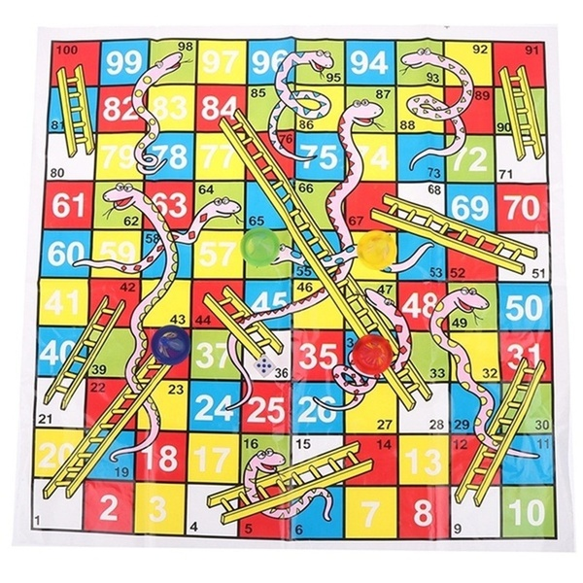
Chutes and ladders
Fully observable vs. partially observable?
Deterministic vs. stochastic?
Episodic vs. sequential?
Static vs. dynamic?
Discrete vs. continuous?
Known vs. unknown?
Single agent vs. multiple agents?

Slide 11
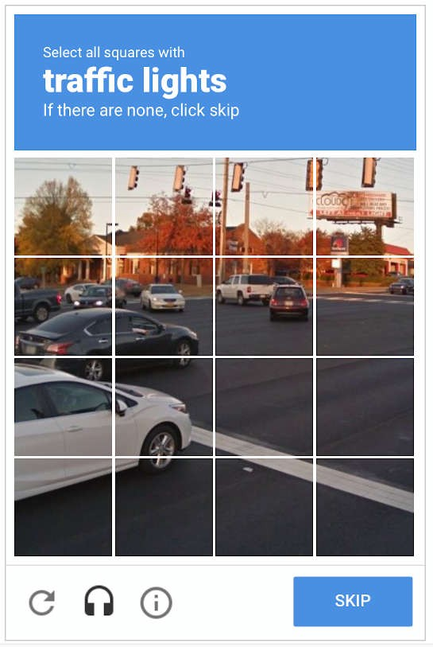
Passing a CAPTCHA
Fully observable vs. partially observable?
Deterministic vs. stochastic?
Episodic vs. sequential?
Static vs. dynamic?
Discrete vs. continuous?
Known vs. unknown?
Single agent vs. multiple agents?

Slide 12
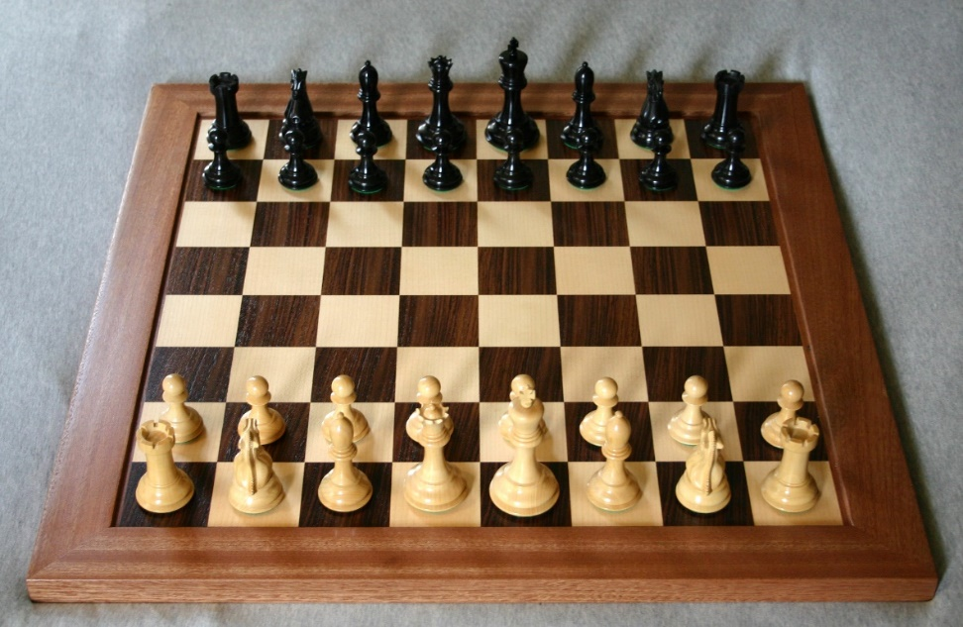
Chess
Fully observable vs. partially observable?
Deterministic vs. stochastic?
Episodic vs. sequential?
Static vs. dynamic?
Discrete vs. continuous?
Known vs. unknown?
Single agent vs. multiple agents?

Slide 13
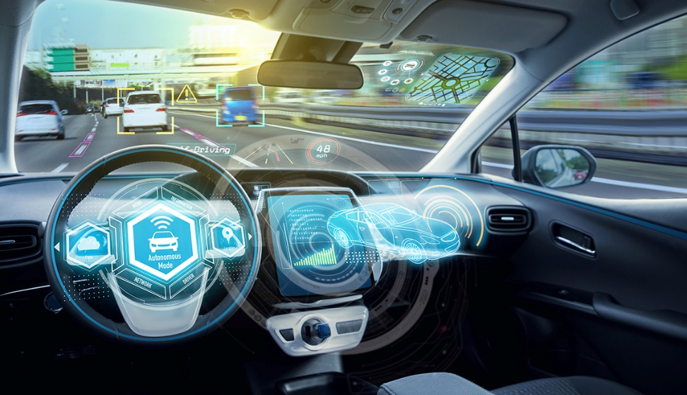
Driving a car
Fully observable vs. partially observable?
Deterministic vs. stochastic?
Episodic vs. sequential?
Static vs. dynamic?
Discrete vs. continuous?
Known vs. unknown?
Single agent vs. multiple agents?

Slide 14
Class work
List the properties for each of the previous tasks
Chutes and ladders
Passing a CAPTCHA
Chess
Driving a car

Slide 15
References
Russel and Norvig, Artificial Intelligence: A Modern Approach, 3rd edition, Prentice Hall, 2010. Chapter 3.3

